Slide 1

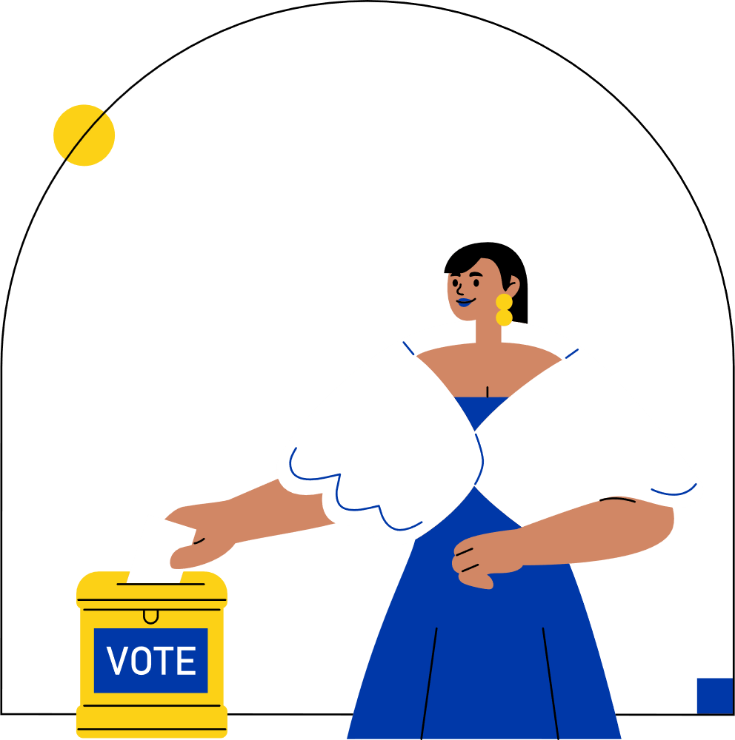

VISUALIZING ELECTION
DATA FOR A NEWS COMPANY
PRESENTED BY:
TEAM 4
BHUMI KALA
SANTOSH SK
SRINIBAS MASANTA
VAIBHAV YADAV

Slide 2

TOPIC OUTLINE
INTRODUCTION
STAR SCHEMA
DATASET OVERVIEW
DASHBOARD
CONCLUSION
DATA CLEANING
02

Slide 3
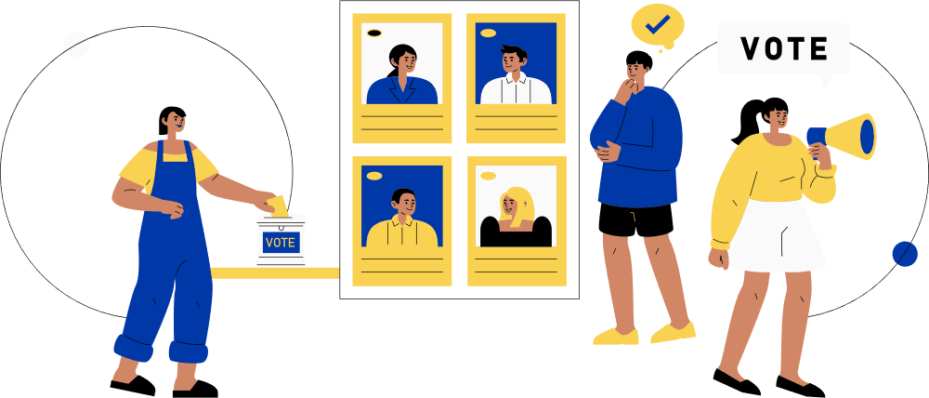

INTRODUCTION
In today’s fast-paced election environment, news agencies need accurate and real-time visualizations to effectively report voting trends and results. This project addresses that need by integrating complex election data from multiple sources into Power BI dashboards. These dashboards provide clear insights into vote shares, turnout patterns, party trends, and constituency-level performance, enabling journalists and editorial teams to analyze and present election data with clarity and speed. The solution is designed to be scalable and adaptable, supporting real-time updates and detailed demographic analysis to enhance news coverage and public understanding.
03

Slide 4





WHY USE POWER BI?
Power BI is Microsoft’s business intelligence tool that transforms raw data from multiple sources into interactive, real-time, and visually compelling insights for better decision-making.
Data Integration Power
Visualization & Storytelling
Cost & Usability Advantage
Real-Time Analytics
Data Modeling Capabilities
Cost-effective alternative to enterprise BI tools like Tableau or Qlik.
User-friendly with a low learning curve, ideal for non-technical staff.
Live Data: Supports live data refresh for real-time election reporting.
Timeliness: Crucial for high-stakes, time-sensitive environments like elections.
Supports star schema design, relationships, hierarchies, and measures (DAX).
Handles large-scale datasets efficiently, ensuring accuracy.
Multiple Sources: Connects to CSV, Excel, APIs, databases, and real-time feeds.
Unified Data: Combines historical and live election data in one platform.
Interactive visuals for complex electoral data.
Easy for journalists to interpret vote shares, turnout, and maps.
04

Slide 5
Constituency Information
Contains details about each parliamentary and assembly constituency.
Includes unique IDs, constituency names, and mapping to states.
State & Region Mapping
ABOUT THE DATASET
Each constituency is linked with its state and region.
Enables state-level comparisons and aggregated insights.
Electoral Boundaries
“The dataset contains detailed information on parliamentary and assembly constituencies, including IDs, names, and state mapping. It forms the backbone of the star schema, enabling constituency-level analysis of votes, candidates, and parties.”
Records boundary definitions to track constituency-level changes across elections.
Important for historical consistency and trend analysis.
Demographic Coverage
Captures urban–rural distribution and other constituency-level attributes.
Supports deeper insights into voter behavior and turnout trends.
Analytical Relevance
Serves as a dimension table in the Power BI star schema.
Forms the backbone for linking votes, candidates, and parties to their respective constituencies.
05

Slide 6

DATA CLEANING
Data cleaning ensures the constituency dataset is accurate, consistent, and standardized by removing duplicates, handling missing values, and validating mappings before integration into Power BI.
06

Slide 7
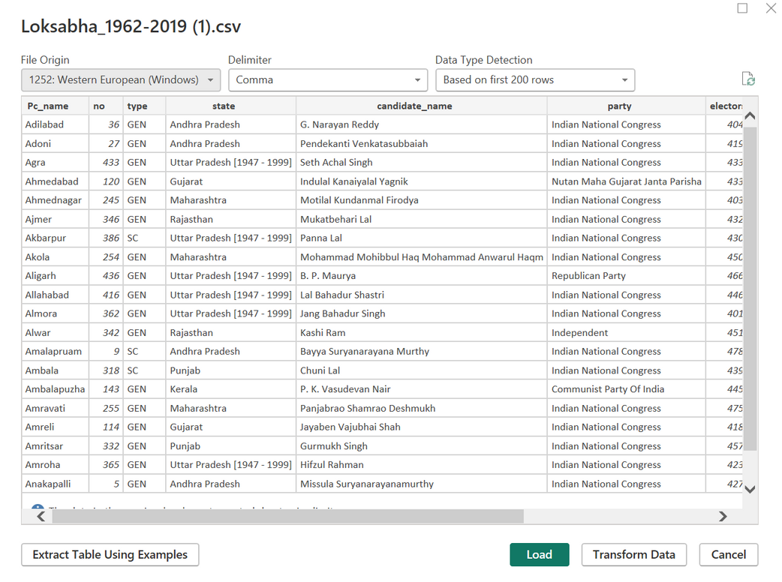
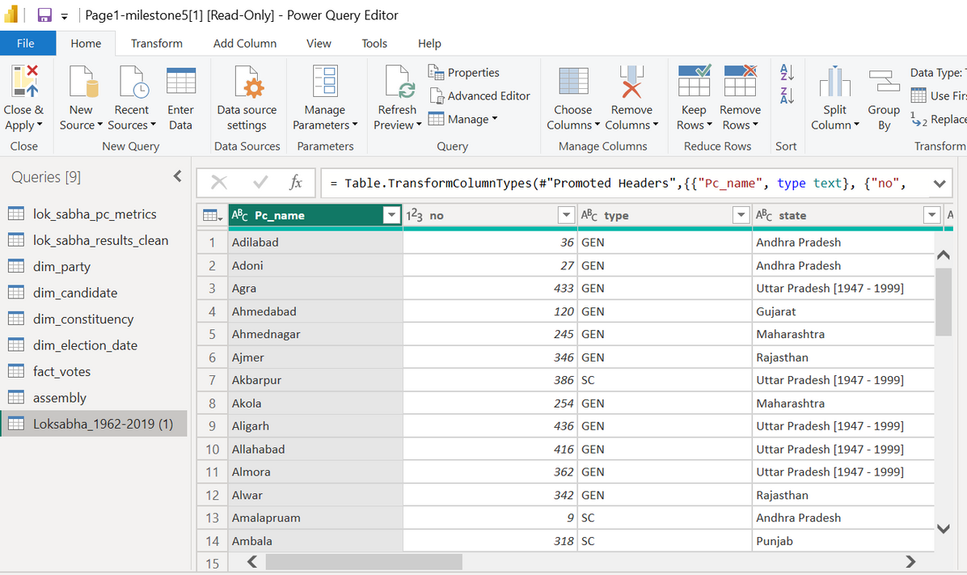
DATA CLEANING & TRANSFORMATION IN POWER BI (POWER QUERY)
Imported & inspected raw CSV (Loksabha 1962–2019) in Power Query Editor
Standardized text using Trim, Clean, and Capitalize Each Word
Unified naming for parties and constituencies (e.g., “BJP”, “Bharatiya Janata Party” → “Bharatiya Janata Party”)
Set correct data types for all columns (Year → Number, Votes → Whole Number, etc.)
Created derived columns such as Vote Share (%) and Result (Winner/Loser)
Validated final data model consistent, complete, and ready for dashboard integration.
Set correct data types for all columns (Year → Number, Votes → Whole Number, etc.)
Created derived columns such as Vote Share (%) and Result (Winner/Loser)
Validated final data model consistent, complete, and ready for dashboard integration.
Renamed columns for clarity (e.g., Cand_name → Candidate Name)
Removed duplicates & null entries to ensure accuracy.

Slide 8
DATA INTEGRATION THROUGH API
API = Application Programming Interface
Acts as a bridge between data source and application
Enables real-time, structured, and automated access to datasets
Industry value: APIs reduce manual data handling and ensure consistency.
Source: [Datameet India Election Data API]
Taken from Github
Provides assembly election data across states and years
API Link: https://raw.githubusercontent.com/datameet/india-election-data/refs/heads/master/assembly-elections/assembly.csv
Data points include:
State & constituency
Candidate & party
Votes received
Election year
08

Slide 9
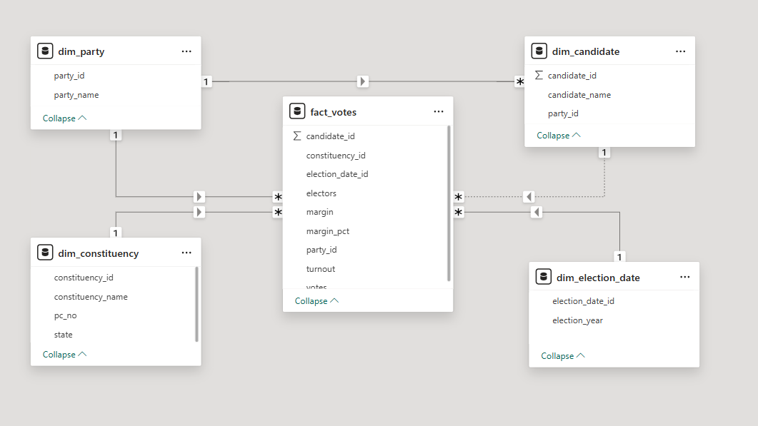
STAR SCHEMA
A star schema is a data warehousing model with a central fact table linked to multiple dimension tables, making data easier to analyze and query.
The fact table (fact_votes) sits at the center and stores measurable data like votes, turnout, and margins, with references to dimension tables.
Dimension tables (dim_party, dim_candidate, dim_constituency, dim_election_date) describe context such as parties, candidates, constituencies, and election dates.
Each dimension table connects to the fact table using foreign keys, enabling flexible filtering and grouping.
09

Slide 10


HISTORICAL TRENDS DASHBOARD
Elections are not just numbers; they are stories of shifting public trust.
Historical vote shares and turnout patterns reveal:
What drives voter behavior?
Where do parties rise or decline?
Which regions decide outcomes?
Our dashboard turns raw data into narratives of democracy.
10

Slide 11
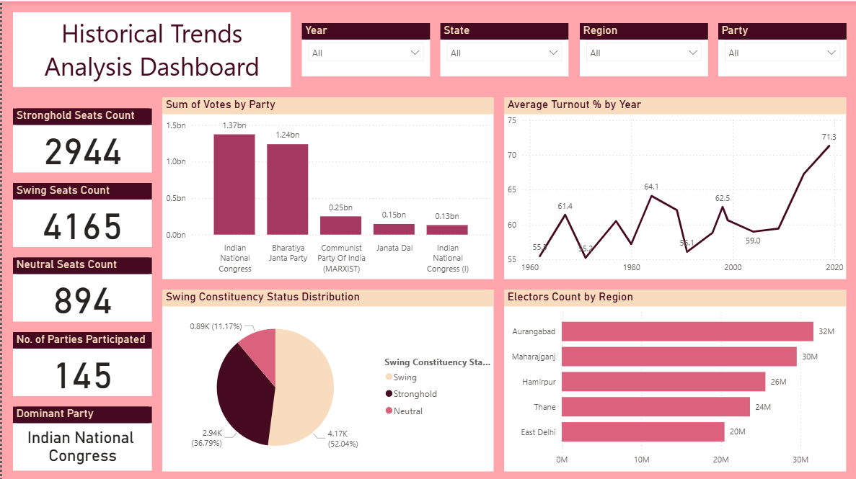
DASHBOARD

Slide 12
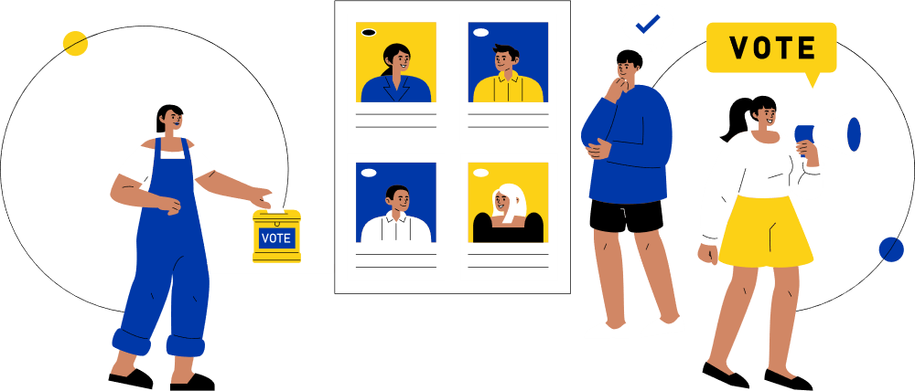
DEMOGRAPHIC TRENDS
Lok Sabha Election Insights
Scale: 834M electors, 8,047 candidates, 2,562 constituencies, 145 parties.
Key Findings:
Mulayam Singh Yadav represents the largest electorate (12M+), followed by other political heavyweights.
Candidate gender breakdown reveals male dominance across parties; female representation remains low.
Seats won are distributed across key constituencies, allowing identification of major strongholds and local dynamics.
12

Slide 13
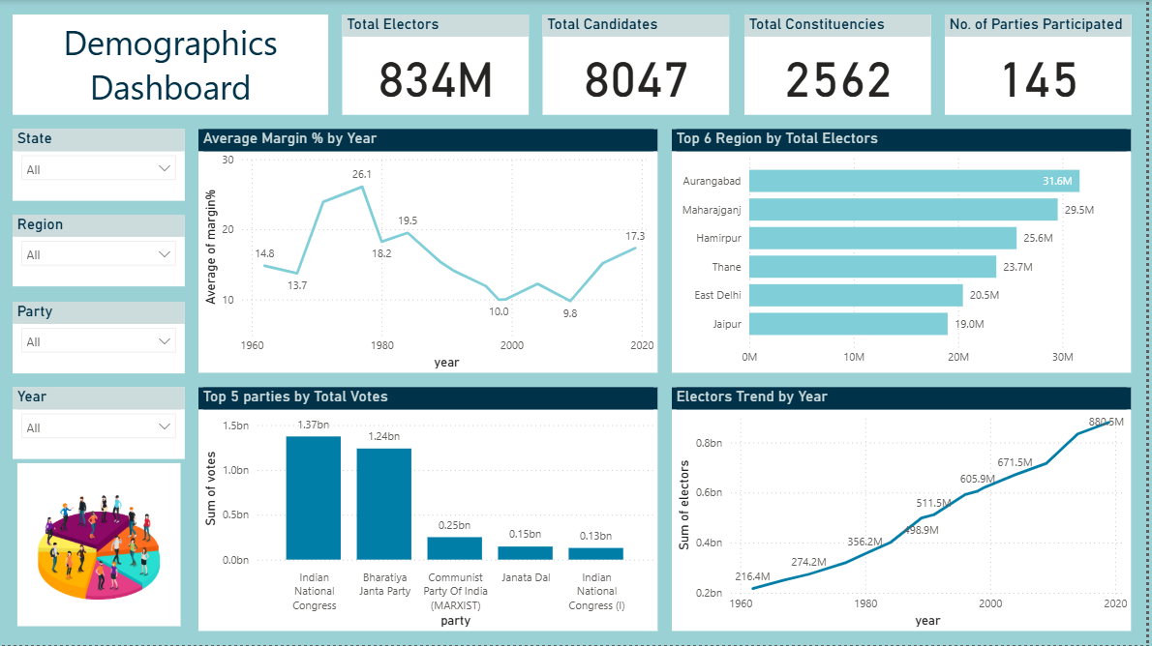
DASHBOARD

Slide 14


RURAL VOTER DYNAMICS
Why Is This Important?
Rural voters often determine election outcomes in India due to their significant population share and potential for high engagement. Some states like Uttar Pradesh, Bihar, and Maharashtra have rural voter numbers in tens of millions, shaping national and local election strategies. High turnout percentages in states such as Nagaland and Lakshadweep reveal areas with exceptional voter mobilization.
14

Slide 15
WHAT IS DRILL THROUGH?
Drill Through enables navigation from a summary dashboard to a detailed report page focused on a specific item like a region, candidate, or product.
When viewers right-click or select a data point, Power BI automatically opens a target page filtered to show granular details for that item only.
This makes analysis deeper and interactive, letting users explore the underlying reasons behind summary insights without cluttering the main dashboard.
Example: From overall state results, drill through to see details of a single state's voter turnout, candidate breakdown, or sales figures.
Why use it?
Enables focused, actionable insights.
Keeps dashboards clean while letting users investigate details as needed.
03

Slide 16
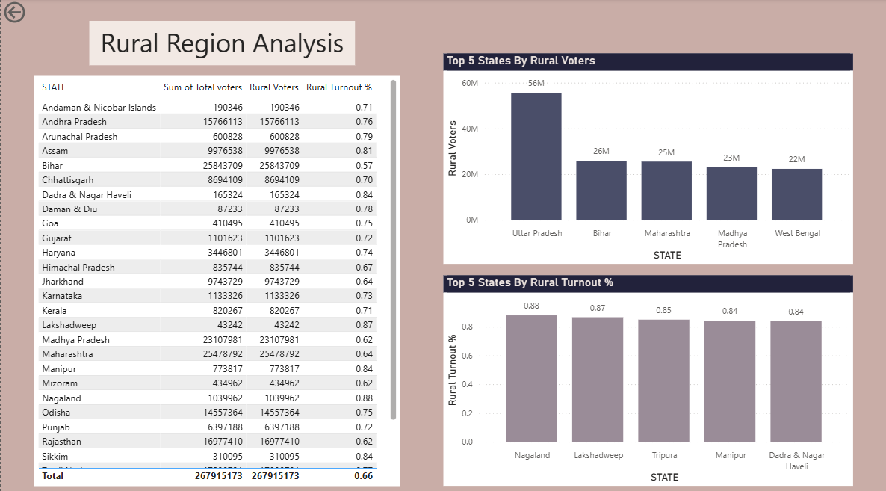

Slide 17

URBAN VOTER LANDSCAPE: SCALE AND ENGAGEMENT
Urban regions are critical for electoral victory due to their dense populations and issue-driven voting patterns.
West Bengal, Uttar Pradesh, and Maharashtra top the chart in urban voter numbers, but turnout remains modest at 65% lower than rural India's rate.
Despite higher literacy and awareness, urban apathy is evident; however, places like Puducherry and West Bengal show turnout above 80%.
Boosting urban participation is essential for fair representation and unlocking the full power of India’s democracy.
16

Slide 18
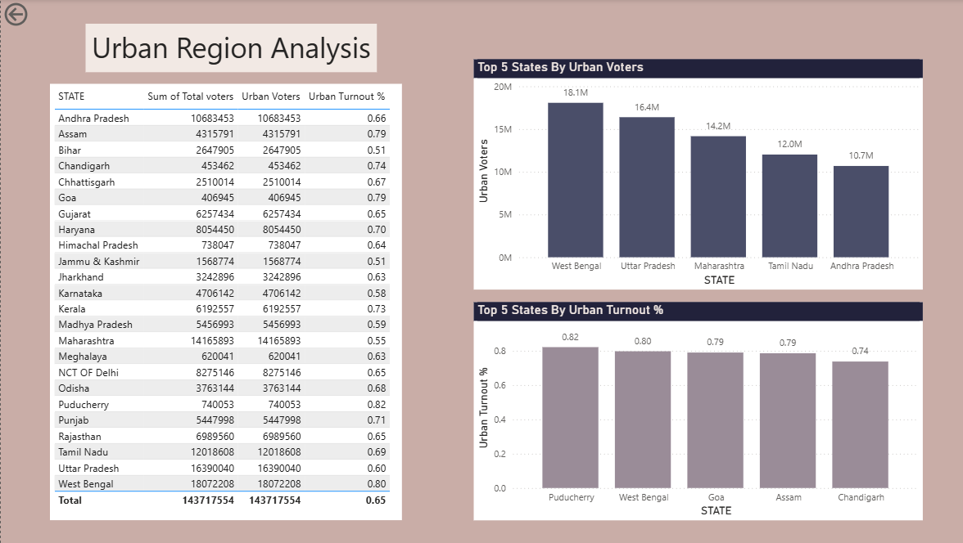

Slide 19
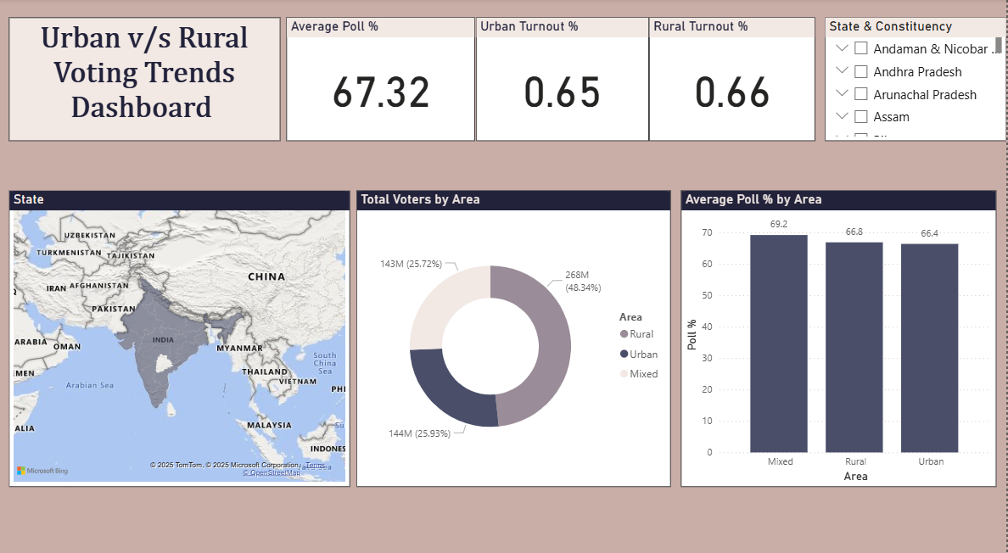
DASHBOARD

Slide 20


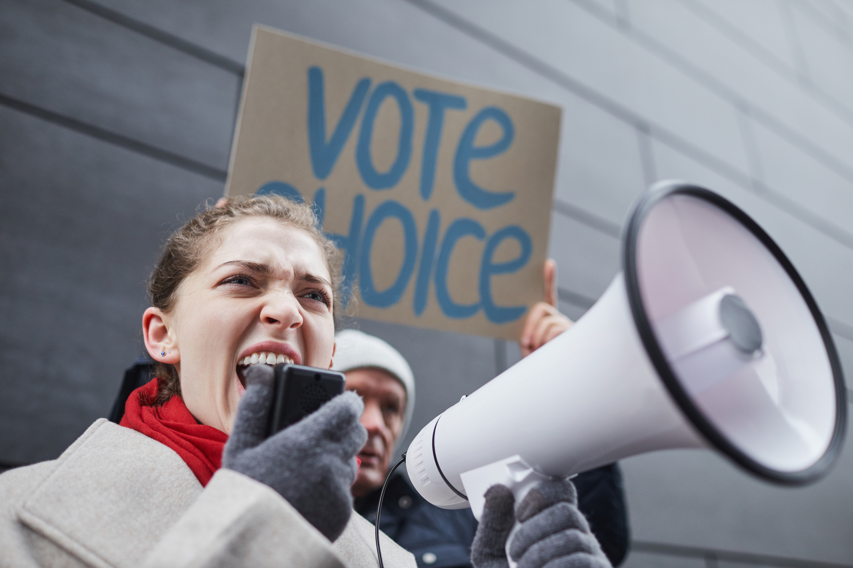

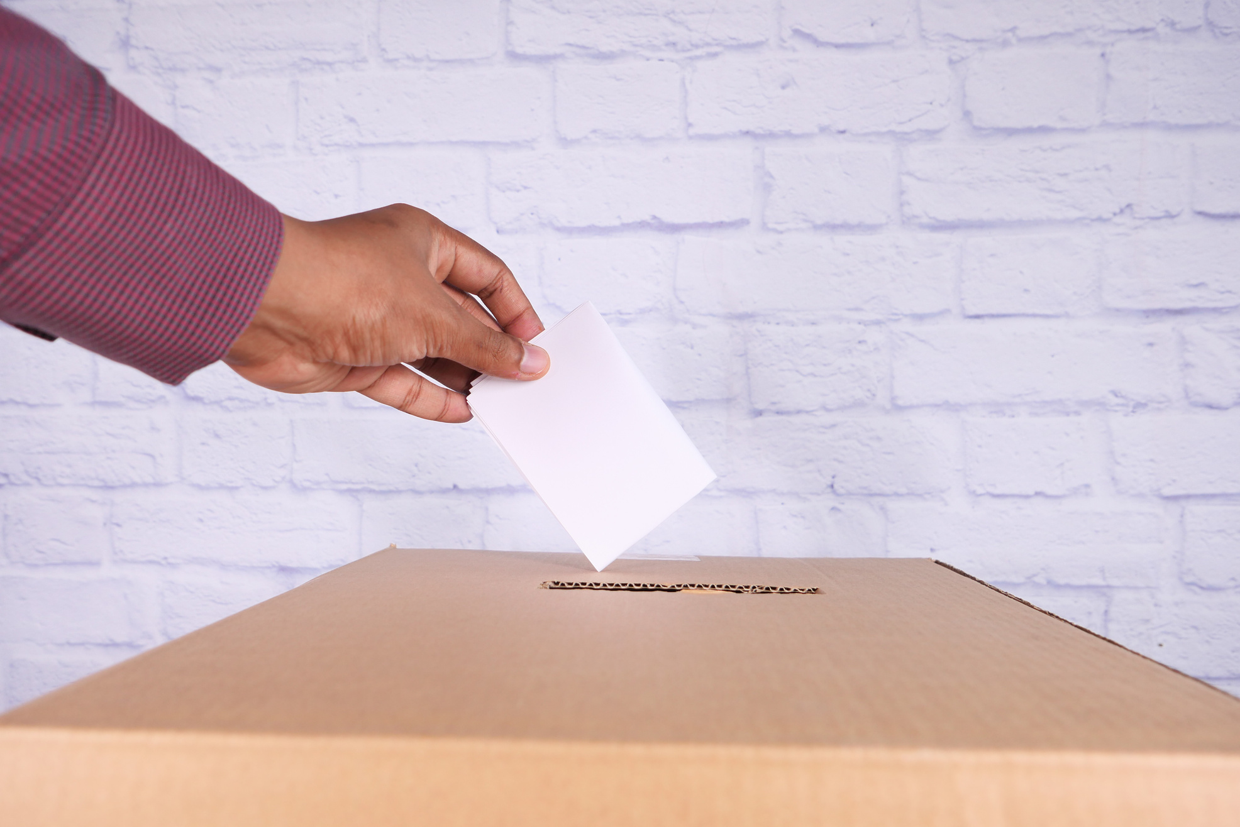

YOUR VOTE
MATTERS
09

Slide 21
CONCLUSION
This project demonstrates how advanced data analytics and visualization in Power BI can transform raw election data into actionable insights for policymakers, campaigners, and the public. By integrating demographic breakdowns, urban and rural region analyses, and interactivity features like drill-through, the dashboard reveals both macro and micro-level trends in Indian elections.
Key takeaways include the dominance of certain states and candidates in the electorate, the persistent gender gap, and the contrasting turnout dynamics between rural and urban India. The project highlights untapped opportunities to boost urban voter participation and better represent demographic diversity.
03

Slide 22
THANK YOU FOR LISTENING!
10

